Slide 1
Developing Others
(insert date)

Slide 2
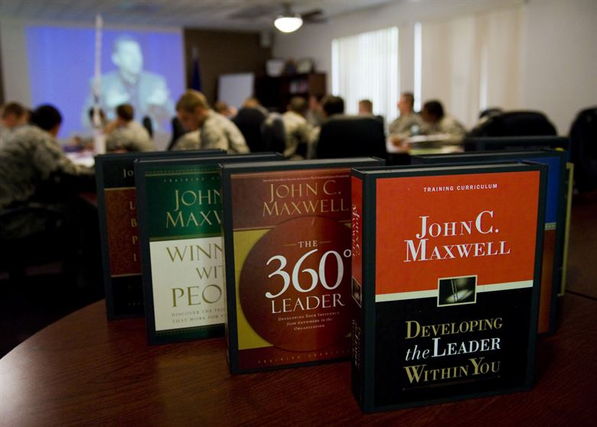
Leaders Add Value
The core of leadership – what’s essential – is that leaders add value to people.
John C. Maxwell
Pastor and author of more than 20 books on leadership
John C. Maxwell leadership books, and both live and recorded seminars, are used throughout the Department of the Air Force for leader development. U.S. Air Force photo by Airman Basic Jamie L. Nicley

Slide 3
Objectives
By the end of this lesson, you will be able to:
Understand the importance of developing others.
Identify types of development opportunities.
Facilitate the development of others from a personal, mission, and career perspective.

Slide 4
Small Group Discussion
In your small groups, discuss:
What does developing others mean?
Why is developing others important?
How have you (or others) been developed?
Five (5) minutes – then be prepared to brief your results

Slide 5
Large Group Discussion
What does developing others mean?
Why is developing others important?

Slide 6
Knowledge, Skills, and Abilities
Knowledge: Information applied to a function
You “know” the contents of a Tech Order or manual
Skill: An observable competence
Flying a plane
Ability: An observable behavior competence
You are a proficient pilot, based on a combination of flight knowledge and piloting skills applied over time
Education
Training
Experience

Slide 7
Knowledge, Skills, and Abilities
Knowledge: Information applied to a function → Education
Skill: An observable competence → Training
Ability: An observable behavior competence → Experience
What types of development activities did you come up with earlier?

Slide 8
Sample Development Activities
Knowledge (thru Education) | Skills (thru Training) | Abilities (thru Experience)
Professional Military Education (education programs) | Professional Military Education (training/hands-on programs) | Professional Military Education (long-term resident programs, tech schools, etc.)
 |  | Assignments (in-career field and career broadening)
Initial Qualification Training (knowledge portion) | Initial Qualification Training (hands-on portion) | Unit Qualification Training
Continuing education programs (on or- off-duty) | Skill-development programs | Seminars / conferences (TDY)
Self-directed (or commander-directed) study | Self-directed (or commander-directed) practice | Recurring training / advanced training (TDY)
Informal discussions |  | Relationship-building
Book clubs, book reports
Teaching | Coaching | Mentoring

Slide 9
Developing Your Flight
How do you develop your flight?
Step 1: Assess Developmental Needs
What do your people need?
Personal goals, mission requirements, career growth
Step 2: Identify Development Opportunities
What opportunities are available?
No pre-defined education or training opportunities? Create a unique experience.
Step 3: Support Development Opportunities
Nominate individuals for training or education
Advocate for use of funds
Coordinate opportunities (TDY, course dates, etc.)
Conduct local opportunities

Slide 10
Development Activity
Part 1 – Individual Work
Fill-in Developing Your Flight Worksheet
Got questions?
5 minutes, then Part 2

Slide 11
Development Activity
Part 1 – Individual Work
Fill-in Developing Your Flight Worksheet
Got questions? Ask.
Part 2 – Group Discussion
In your small groups,
Discuss your results
Close gaps in your knowledge
Share development ideas
Each group then summarize findings with class to wrap up
10 minutes

Slide 12
Creating a Learning Environment
Developing others is the most rewarding part of your mission.
To ensure success, create a “learning environment”
Remove barriers to learning
Encourage potential
Motivate others to develop
… to produce positive results

Slide 13
Self-Assessment Exercise
Honestly assess yourself against the listed criteria
Results are private – sharing is not the intended goal
Contemplate steps for future improvement
You will need these worksheets to finish your Personal Development Plan (PDP) and complete this course.

Slide 14
Break
Come back in 10 minutes!

